Slide 1
SQL--- MODULE III

Slide 2
main SQL command for data definition is the CREATE statement
CREATE SCHEMA COMPANY AUTHORIZATION ‘Jsmith’;
CREATE TABLE COMPANY.EMPLOYEE ...
CREATE TABLE EMPLOYEE
CREATE DOMAIN SSN_TYPE AS CHAR(9);

Slide 3
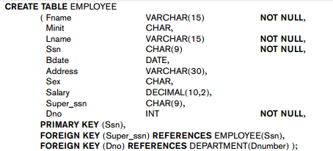

Slide 4
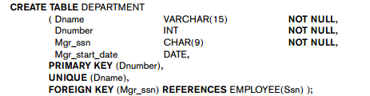

Slide 5
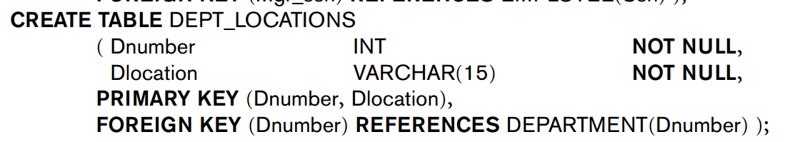

Slide 6
Constraints in sql
Attribute Constraints and Attribute Defaults
NOT NULL
default value DEFAULT <value>….. If no default clause is specified, the default default value is NULL for attributes that do not have the NOT NULL constraint.
CHECK

Slide 7
Constraints in sql
Specifying Key and Referential Integrity Constraints
PRIMARY KEY clause
Dnumber INT PRIMARY KEY
UNIQUE
Dname VARCHAR(15) UNIQUE;
3. FOREIGN KEY clause for referential integrity

Slide 8
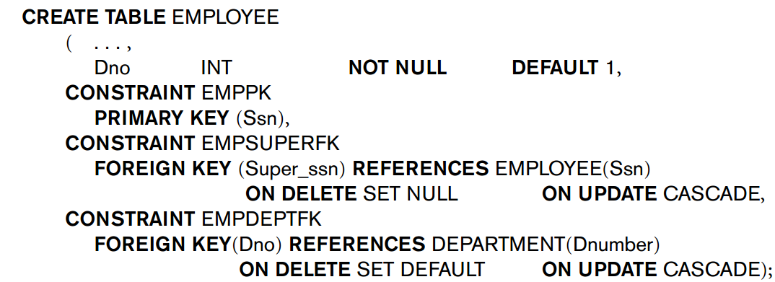

Slide 9
Giving Names to Constraints
constraint may be given a constraint name, following the keyword CONSTRAINT

Slide 10
Specifying Constraints on Tuples Using CHECK
CHECK (Dept_create_date <= Mgr_start_date);

